Slide 1

Blood Bank And Donation
Shafayet Nur
Lecturer
Department of Computer Science and Engineering
Port City International University.
Advisor

Slide 2

Team Members
Shaik Abdul Ahad
Raisul Islam Asad
CSE 029 07666
Batch: CSE 29 E A
CSE 029 07674
Batch: CSE 29 E A
Sugiris Tanchangya
Sharmin Akter
CSE 029 07659
Batch: CSE 29 E A
CSE 029 07680
Batch: CSE 29 E A

Slide 3
Overview
Introduction
Features and Functionality
Problem Statement
Benefits of Proposed System
Motivation
Conclusion
Aim and Objectives
References
Present System Limitations
Q&A
System Architecture
Flow Chart

Slide 4

Introduction
A web-based blood donation management system
Built using HTML, CSS (Tailwind + DaisyUI), PHP, and MySQL
Facilitates connection between blood donors and recipients
Features responsive design for all devices
Includes comprehensive donor management system

Slide 5

Current Challenges in Blood Donation Management:
Problem Statement
Difficulty in finding blood donors during emergencies
Lack of centralized donor database
Inefficient manual donor record management
Limited accessibility to donor information
Time-consuming donor search process
No real-time donor availability tracking

Slide 6

Save lives through efficient blood donor management
Bridge the gap between donors and recipients
Reduce time spent finding matching blood donors
Create a user-friendly platform for blood donation
Modernize the blood donation process
Encourage more people to become donors
Motivation

Slide 7
Aim and Objectives
Primary Aim
Objectives
To develop a comprehensive web-based blood bank management system that efficiently connects blood donors with recipients
Create a user-friendly donor registration system
Implement efficient donor search functionality
Develop a responsive web interface
Establish a secure database for donor information
Provide educational content about blood donation
Enable quick access to donor information in emergencies

Slide 8

Manual record keeping
Prone to errors
Time-consuming
Difficult to update
01.
Present System Limitations
Communication gaps
Delayed response time
Limited donor accessibility
Inefficient donor recipient matching
02.
Resource management
Paper-based records
Scattered information
Limited data security
03.

Slide 9
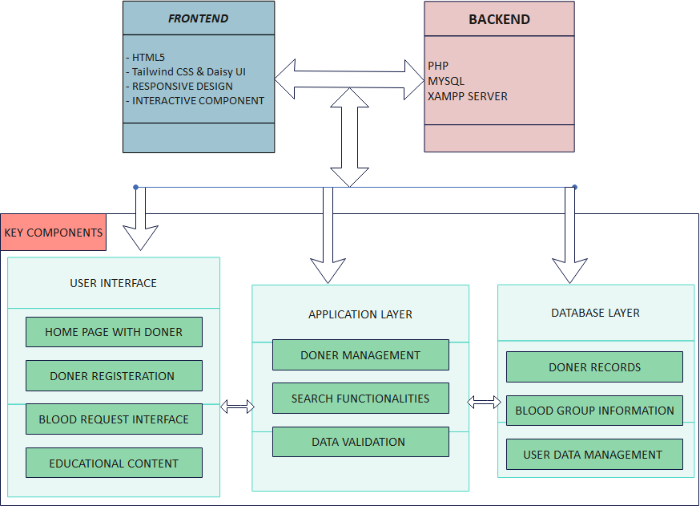
System Architecture

Slide 10
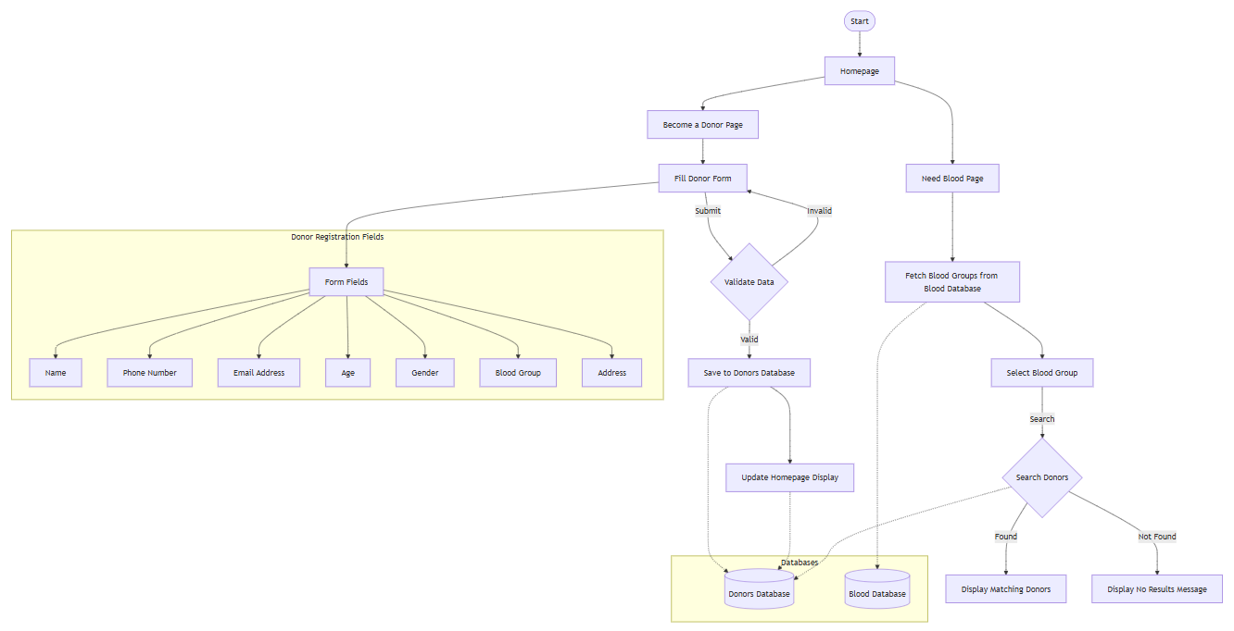
Flow Chart

Slide 11
Features and Functionality
Current Features
Future Features
01
02
03
01
Homepage
Donor information cards
Interactive carousel
FAQ accordion
Responsive header and footer
Donor Management
Registration form
Donor database
Information display
Blood Request System
Blood group search
Donor matching
Contact information display
Admin panel
User authentication
Enhanced dashboard
Advanced donor management

Slide 12
Benefits of Proposed System
For Donors
For Recipients
For Administration
General Benefits
Easy registration process
Profile management
Educational resources
Contribution tracking
Quick donor search
Real-time availability
Direct contact information
Multiple blood group options
Centralized database
Efficient management
Data security
Easy updates
Time-saving
Cost-effective
Error reduction
Improved accessibility
Better organization
Enhanced communication

Slide 13
Conclusion
Project Achievements
Future Scope
Successful implementation of core features
Responsive design across devices
Efficient donor management system
User-friendly interface
Admin panel integration
Mobile application development
Advanced search features
Real-time notifications
Impact
Streamlined blood donation process
Improved emergency response
Enhanced donor-recipient connection
Contribution to healthcare system

Slide 14

References
World Health Organization. (2021). Global status report on blood safety and availability. Retrieved from WHO Website
Hossain, M. M., & Hossain, S. M. (2019). An Overview of Blood Bank Management Systems. International Journal of Computer Applications, 182(8), 1-6. doi:10.5120/ijca2019918711
PHP Documentation. (2023). PHP: Hypertext Preprocessor. Retrieved from PHP.net
MySQL Documentation. (2023). MySQL Reference Manual. Retrieved from MySQL.com
W3Schools. (2023). HTML, CSS, JavaScript Tutorials. Retrieved from W3Schools
Tailwind CSS. (2023). Tailwind CSS Documentation. Retrieved from Tailwind UI
daisyUI. (2023). daisyUI Components. Retrieved from daisyUI

Slide 15
Q&A Session
Thank you for listening!

